Slide 1
STATE OF TEXAS v IRINA DUDLEY

Slide 2
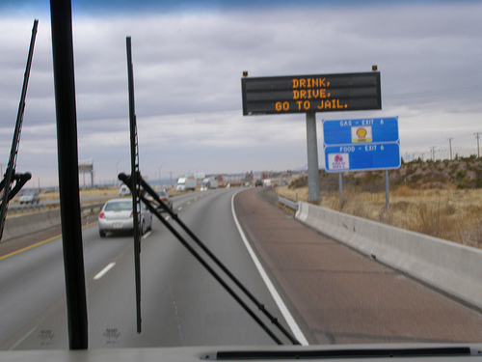
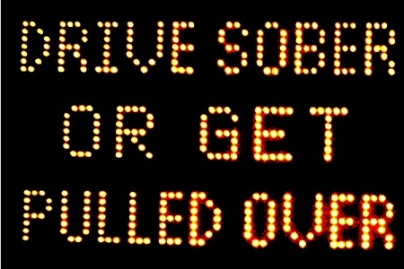
DRINKING
Drink, Drive, Go to Jail
Drive Sober or Get Pulled Over
Going Out Tonight, So Are We

Slide 4
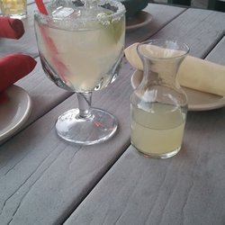
NOT ILLEGAL TO DRINK AND THEN DRIVE; as long as you’re NOT intoxicated

Slide 5
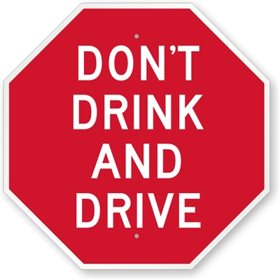
BUT…

Slide 6
DRINKING PATTERNS
A. REGULARLY
B. OCCASIONALLY
C. RARELY
D. NEVER
E. NOT ANY MORE

Slide 7
ALCOHOL RELATED EVENTS
Accident
Arrest
Alcoholism

Slide 9
RELATED TO?

Slide 10
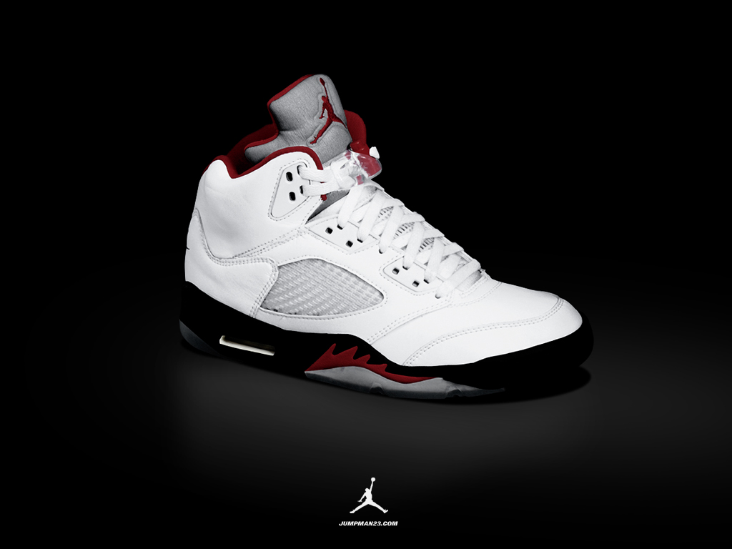
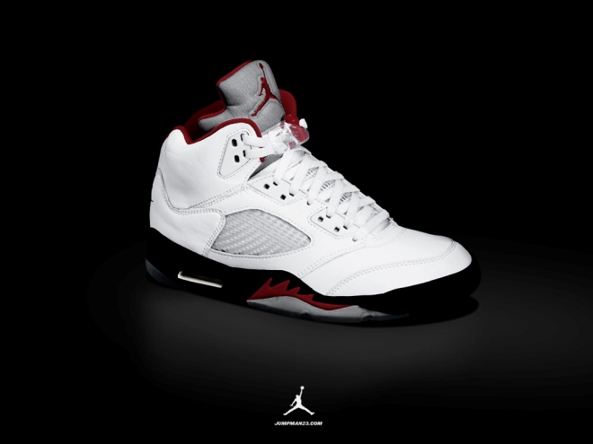
NORMAL v AVERAGE
SIZE 6 SIZE 10

Slide 13
MEDICAL CONDITION
Epilepsy
Polio
Heart Attack
Stroke

Slide 14
CANDIDA ALBICANS

Slide 15
CANDIDIASIS
SKIN
MOUTH
TONGUE
FEET
HAIR
GENITALS

Slide 16
CANDIDIASIS IN GUT

Slide 17
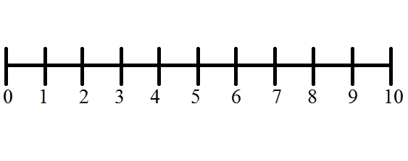
PRESUMPTION OF INNOCENCE
INNOCENT GUILTY

Slide 19
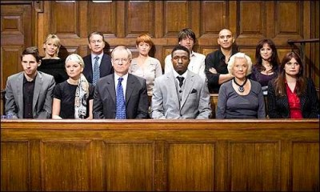
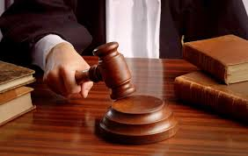
JURY SERVICE

Slide 20
THANK YOU

